Slide 1
AdaNet for Concrete Strength prediction

Slide 2
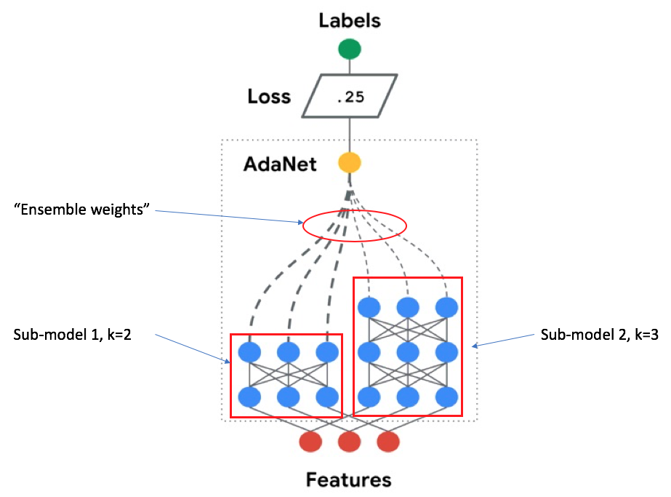
Adaptive Structural Learning (AdaNet)
Ensemble of several subnetworks
Include a candidate subnetwork only when it improves the ensemble’s training loss
https://ai.googleblog.com/2018/10/introducing-adanet-fast-and-flexible.html

Slide 3
AdaNet
Generating subnetworks
Grouping strategy
Combining each group of subnetworks (ensembles)
The best ensemble moves onto the next iteration
Evaluating loss of ensembles

Slide 4
AdaNet
Current Model:
Comparing two subnetworks at each iteration
One of the subnetworks has one additional hidden layer
The number of hidden layer starts from zero

